Slide 1
EncrypZ
The Message Encoder and Decoder

Slide 2
Team members:- Aman Singh (19BCE10160)
Vibhor Bhargava (19BCE10010)
R. Kuringi Selvan (19BCE10433)
Guided By:- Dr. Nitish Andola

Slide 3

Introduction
Secure your Information by Encoding the messages.
Encoding is the process that transforms the text or information to the unrecognizable form, whereas decoding is the process that converts the encrypted message into the original form.

Slide 4

Limitations
Currently there is no direct medium to send message.
The Key also can’t be provided by the user.
Not connected to any database.

Slide 5


Proposed Work
The objective of this project is to encode and decode messages using a common key. This project will be built using the Tkinter and base64 library.
In this project, users must enter the message to encode or decode. Users must select the mode to choose the encoding and decoding process. The same key must be used to process the encoding and decoding for the same message.

Slide 6
Methodology
To build this project we will use basic concepts of Python, Tkinter, and base64 libraries.
The application will be built in the following steps
Import modules
Create display window
Define function
Define labels and buttons

Slide 7

Novelty of the Project
The application provides the users a pleasant GUI to interact with.
It even gives them the liberty to select the mode of encoding/decoding process.

Slide 8



Real Time Usage
The EncryptZ cryptography app can be used by an organisation to encrypt confidential files and documents.
It can also be used by individuals who would like to encrypt confidential information.

Slide 9
Hardware & Software Requirements
Any PC with at least a Pentium processor will be able to run this application. The application wouldn’t require any high specifications to be run.
Minimum software requirement for the application is a functioning Operating System, that is not outdated yet (Eg: Windows 7, 8, 10, Ubuntu, etc., and at least Python v3.0.0.

Slide 10
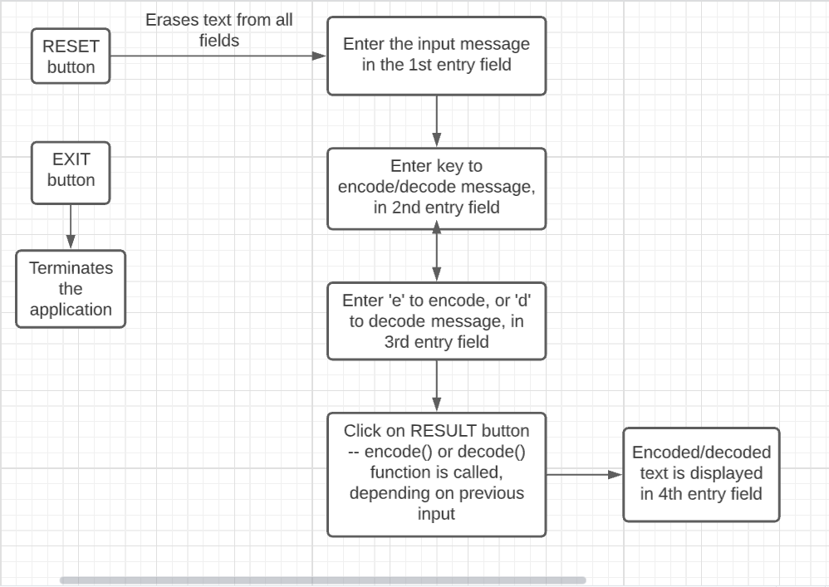
Overall System Architecture Diagram and Workflow Explanation

Slide 11
Literature Review
First, a we click on the EncrypZ executable shortcut, and the application opens.
There are 3 input fields (Message, Key, Mode e/d), and 1 output field for encrypted/decrypted text.
We enter our input message in the 1st field, key in the 2nd one, and ‘e’ to encode or ‘d’ to decode in the 3rd field.
Then, we click on RESULT button to generate the converted text, and the text is displayed in the 4th field.
We click RESET button to clear all the fields, and EXIT button to terminate the application.

Slide 12
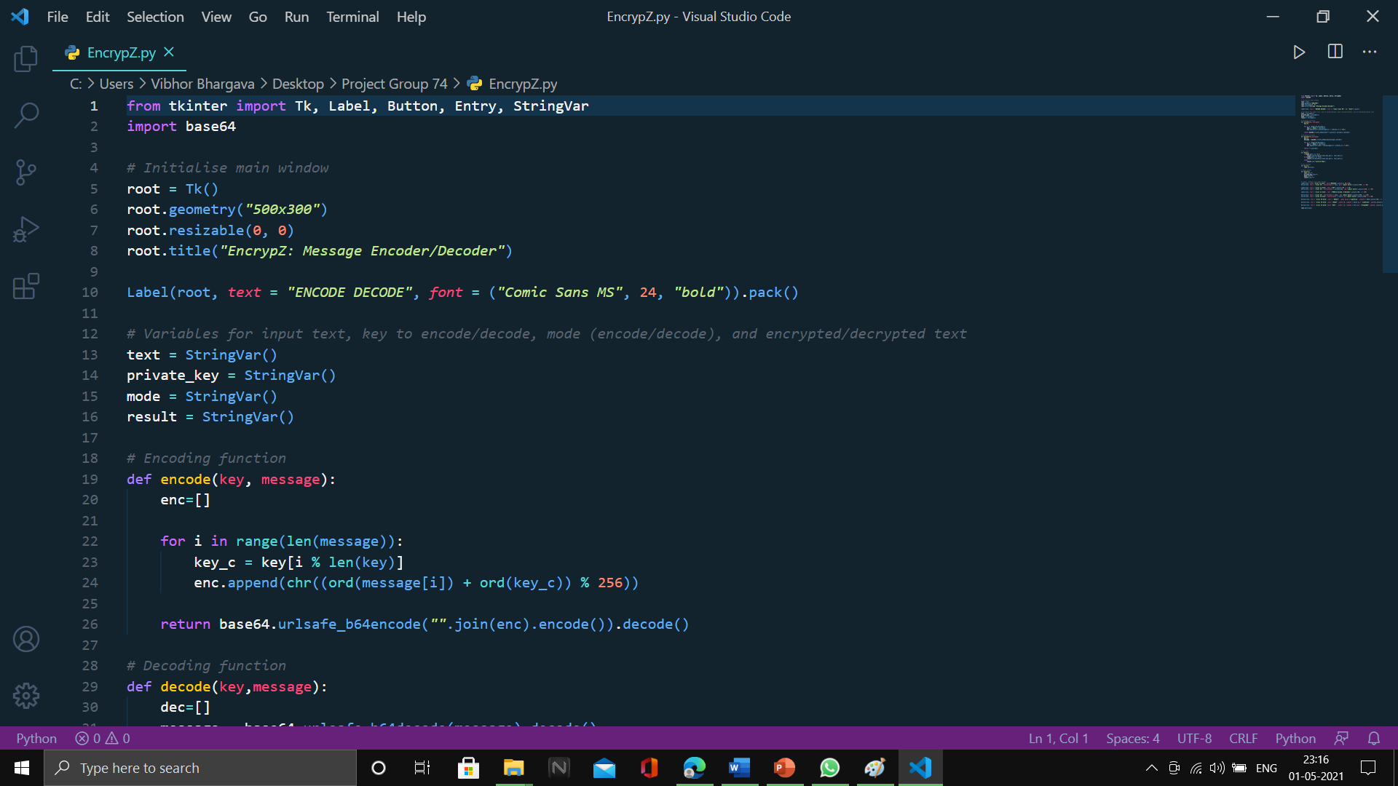
Project Modules and Explanations

Slide 13
encode() Explanation
enc = [] is an empty list
We run loop till the length of the message
i% of len(key) gives the remainder of division between i and len(key) and that remainder used as an index of key the value of key at that index is stored in key_c
ord() function takes string argument of a single unicode character and return its integer unicode value
chr() function takes an integer argument and returns the string.
ord (message[i]) convert the value of message at index i into the integer value
ord(key_c) converts the key_c value to integer value
ord(message[i]) + ord(key_c)) % 256 gives the remainder of division of addition of ord(message[i]) and ord( key_c) with 256 and passes that remainder to chr() function
chr() function converts that integer value to string and store to enc
base64.urlsafe_b64encode encode a string.
encode() method returns utf-8 encoded message of the string.
return gives the result of the encoded string.

Slide 14
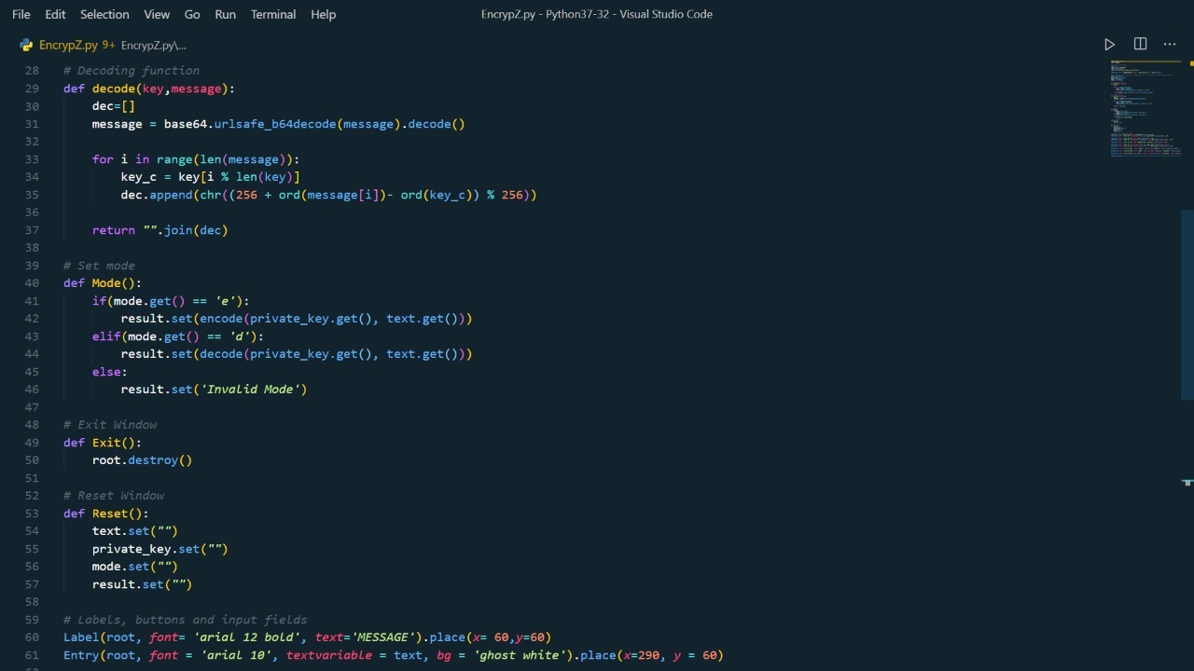

Slide 15
decode() Explanation
dec=[] is an empty list.
Decode the content from input and write the result in binary to the output.
We ran the loop till the length of the message.
256 + ord(message[i]) – ord(key_c)) % 256 gives the remainder of addition of 256 with subtraction of ord(message[i]) – ord( key_c) and then division with 256 and passes that remainder to chr() function.
chr() function convert integer value to string and store to dec.
return “”.join(dec) return the result.

Slide 16
Mode(), Exit(), and Reset() Explanation
If the mode set by the user is ‘e’ then the encode() function will be called.
If the mode set to ‘d‘ then the decode() function will be called.
Else print ‘invalid mode’.
private_key.get() and text.get() values are pass to the arguments of encode() and decode() function.
In Exit() function, root.destroy() will quit the program by stopping the mainloop().
Reset() function sets all variables to empty string.

Slide 17
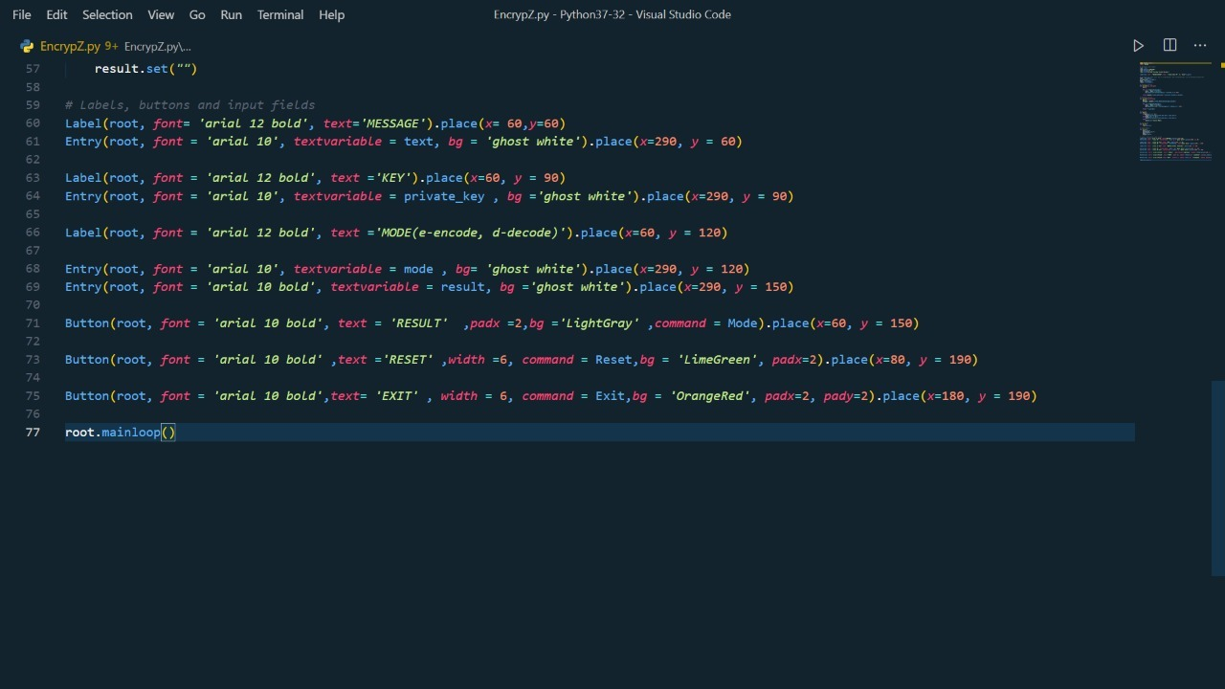

Slide 18
Label(), Entry(), Button() Widgets
Label() widget displays one or more than one line of text that users aren’t able to modify.
Entry() widget is used to create an input text field.
Button() widget displays a button on our window.

Slide 19
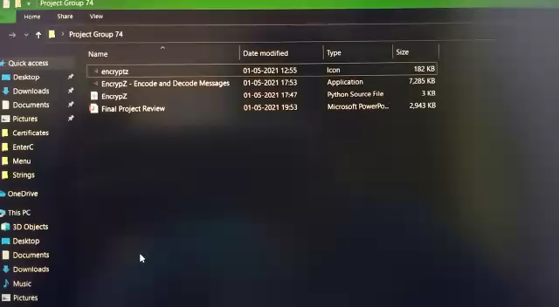
Demo Video

Slide 20
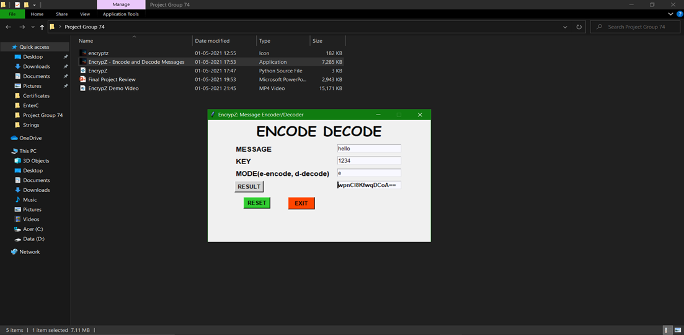
Project Snap Shot

Slide 21
Testing
Initially, we conducted testing at phase level during development cycle or at module level in program code.​
We tried to validate our software as per user experience and that it fully satisfies the need of the user.​
We tried to verify that our software is as per our plan. Main targets of our test were errors, faults and failures.​
During the testing of the accuracy algorithm, it was kept in mind that calculations were done per character.

Slide 22
Input and Output
Input :- Input message, private key, mode of action on text – Encode (e) or Decode (d)
Output :- Converted text

Slide 23
Conclusion
Encryption may seem unnecessary to many people, but in many cases, it is extremely essential in the contemporary world.
For example – Concealing one’s credit/debit card details, Aadhar Card No., etc; an organisation wanting to store some confidential data
As we have seen in this application, it is impossible to relate or decode an encrypted message into its original meaning, without the key and the algorithm.

Slide 24
Thank You!

